Slide 1
AL MULLA EXCHANGE

Slide 2

To Detect whether the given Image is Tampered or Not

Slide 3
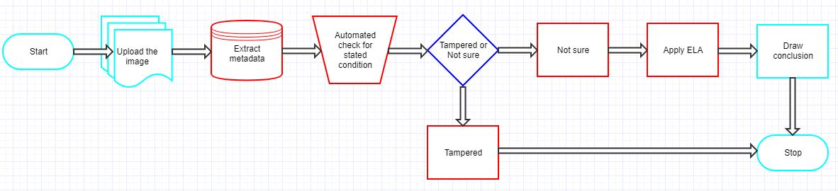
How it works

Slide 4
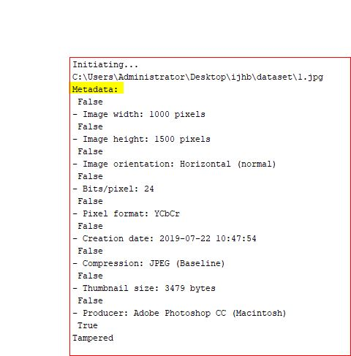
The solution
Check Metadata or Exif Data
When you capture an image using a camera, extra meta information like date, time, camera model, geolocation, etc., are automatically added to it. In some cases, the metadata might also have information about the software that is used to edit or manipulate the image.
Then this information could be used to determine whether the image is Tampered or Not.

Slide 5
The solution
Conditions:-
Check for the Software/ Producer Tags for the Uploaded image.
Check for the tag (Time of creation) from the extracted metadata of the image.
Check for the Source and the country tag.

Slide 6
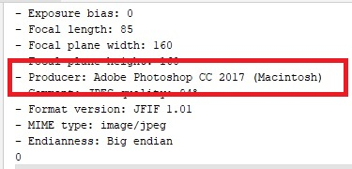
The solution
Condition that can be applied
Check for the Software/ Producer Tags for the Uploaded image.
If the image is edited by any software, then through the metadata
we can get the Tags for the following image.
Now if the given tag says (Producer: Adobe Photoshop) means the uploaded photo was edited.Through (Tampered ) condition we would display the result: The Image was edited.

Slide 7
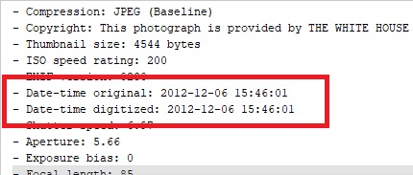
The solution
Condition that can be applied
Check for the (Date-time) of the image:
Through the metadata we can get the date and time of the image.
Setting these parameters would help in sorting the tampered photos.

Slide 8
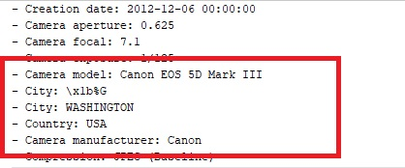
The solution
Check for the Source and the country tag:
Source would determine the device used for the capturing of the image and the country tag would determine the location from which the image was taken from.

Slide 9
THANK YOU

